Slide 1
Slide 1
Best gifts for Valentine
14, February, Monday
2022

Slide 2
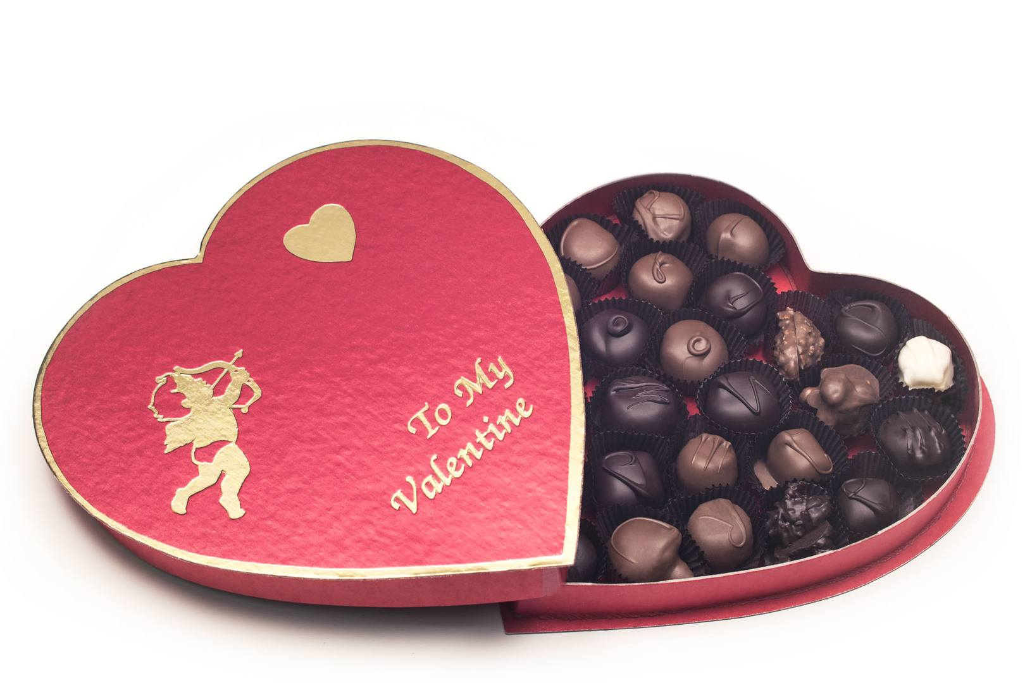
Slide 2
Chocolate box

Slide 3
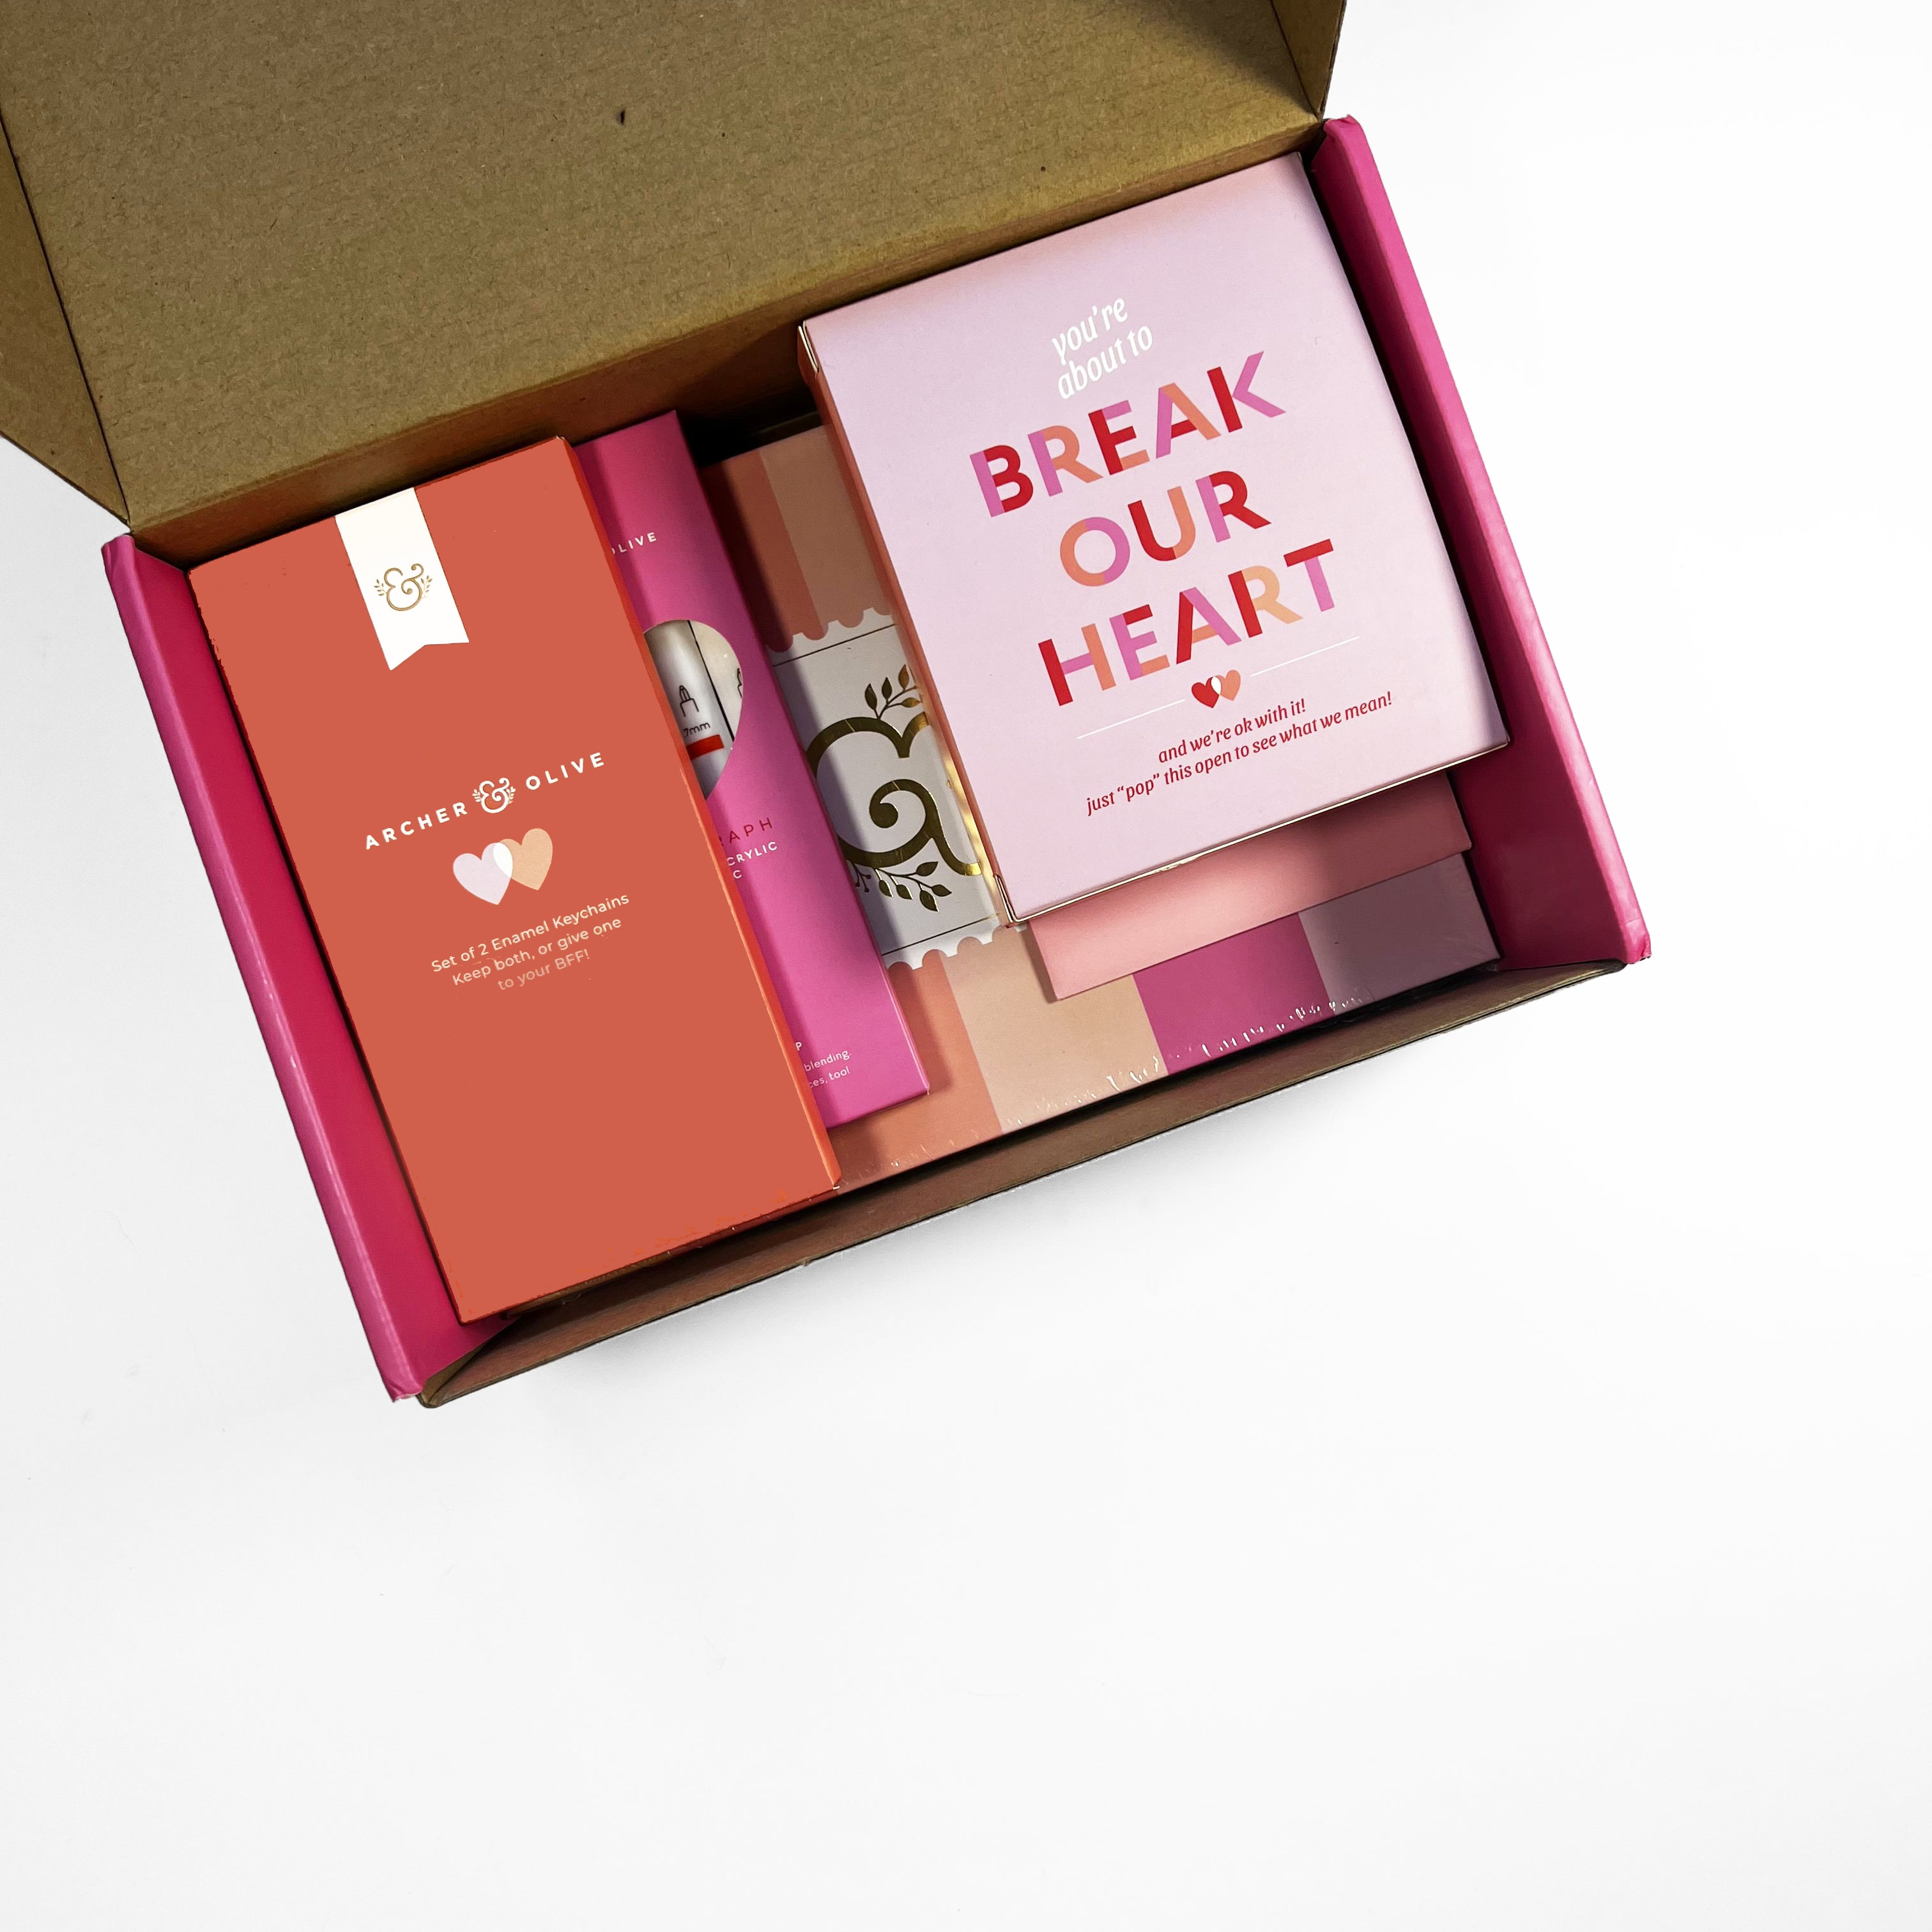
Slide 3
Archer & Olive
Valentine’s Box
You can buy this product from:
https://www.archerandolive.com

Slide 4
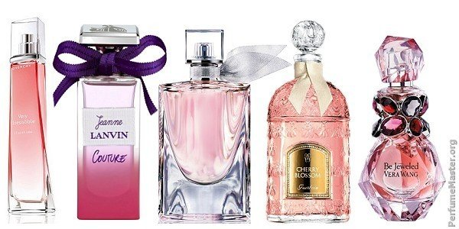
Perfumes:-
Gucci (guilty love), eau de toilette
Tom Ford (grey vitiver) eau de parfum
Creed (Irish tweed) eau de parfum
Prada (l’homme Prada) eau de toilette
Breydo la selection (Valentine) eau de parfum set

Slide 5
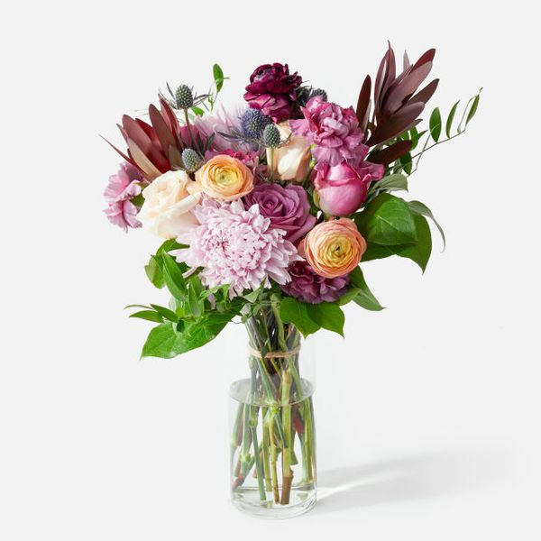
Flowers

Slide 6
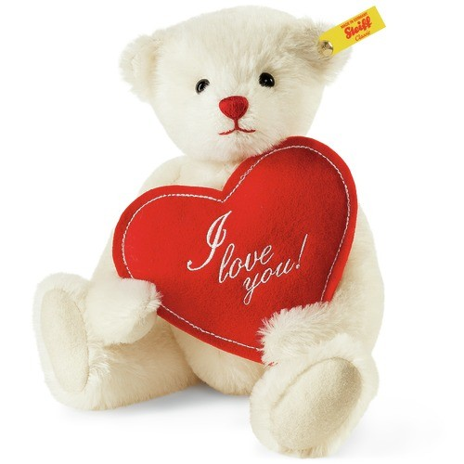
Soft toys

Slide 7
Greeting Cards

Slide 8
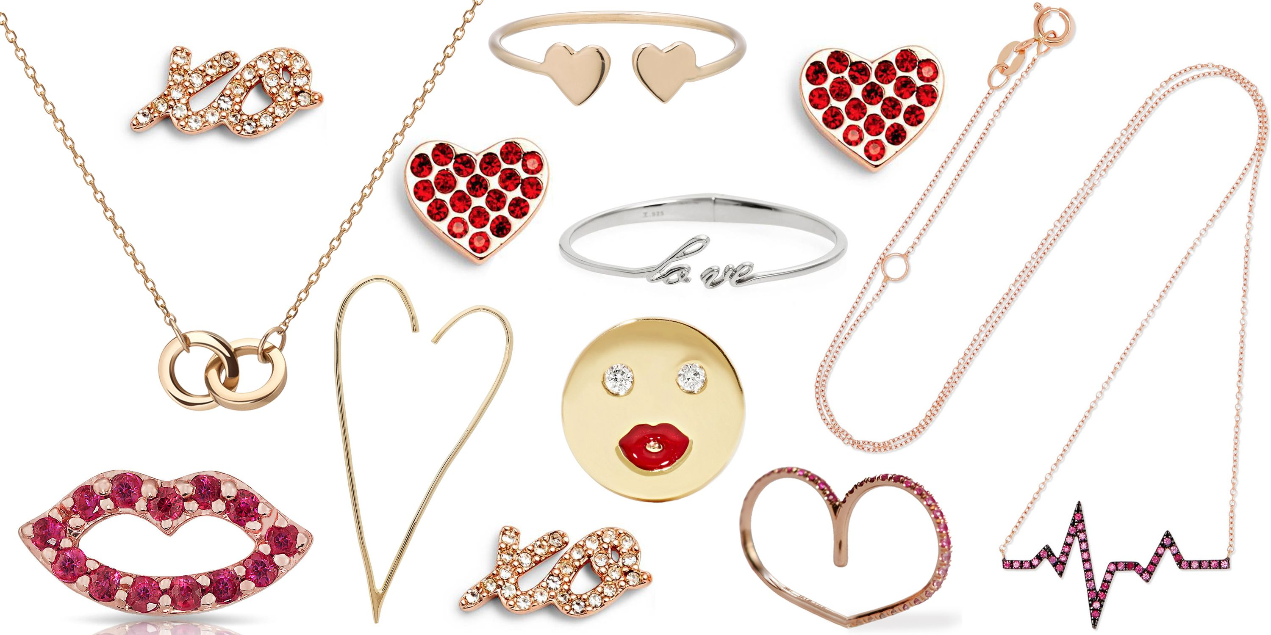
Jewelry

Slide 9
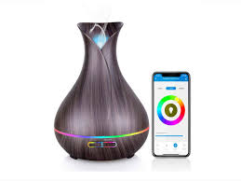
Electronic gadgets

