Slide 1
Dragon Blood Tree
Dragon Blood tree, also known as Dracaena Cinnabari, is the Socotra dragon tree. Socotra is a part of Yemen, located in the Arabian sea.
The tree is called ‘dragon blood tree’ is because the tree produces a Red sap, very alike to blood, which is used for medicines and dye.
Dragon Blood tree is shaped like an umbrella.
It’s fruits are small fleshy berries containing 1 and 4 seeds.
As they develop they turn from green to black, and then become orange when ripe.
The dragon blood tree usually produces it’s flowers around March, though flowering does vary with location.
The first description of Dracaena Cinnabari was made during a survey Socotra led by Lieutenant Wellsted of the East India Company in 1835. It was first named Pterocarpus Draco, but in 1880 the Scottish botanist Isaac Bayley Balfour made a formal description of it and renamed it as Dracaena Cinnabari.
Between 60 and 100 Dracaena species, D. Cinnabari is one of only six species that grow as a tree.

Slide 2
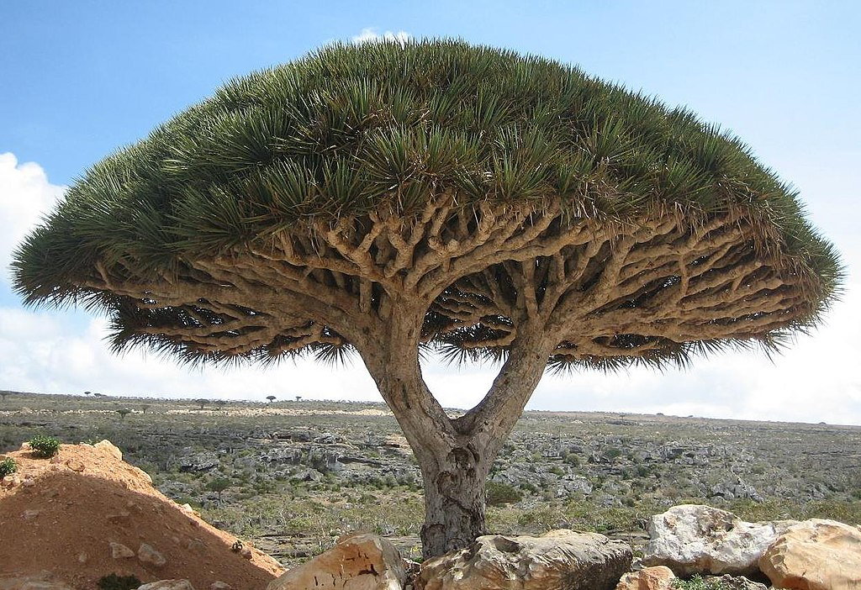
Dragon Blood Tree

