Slide 1
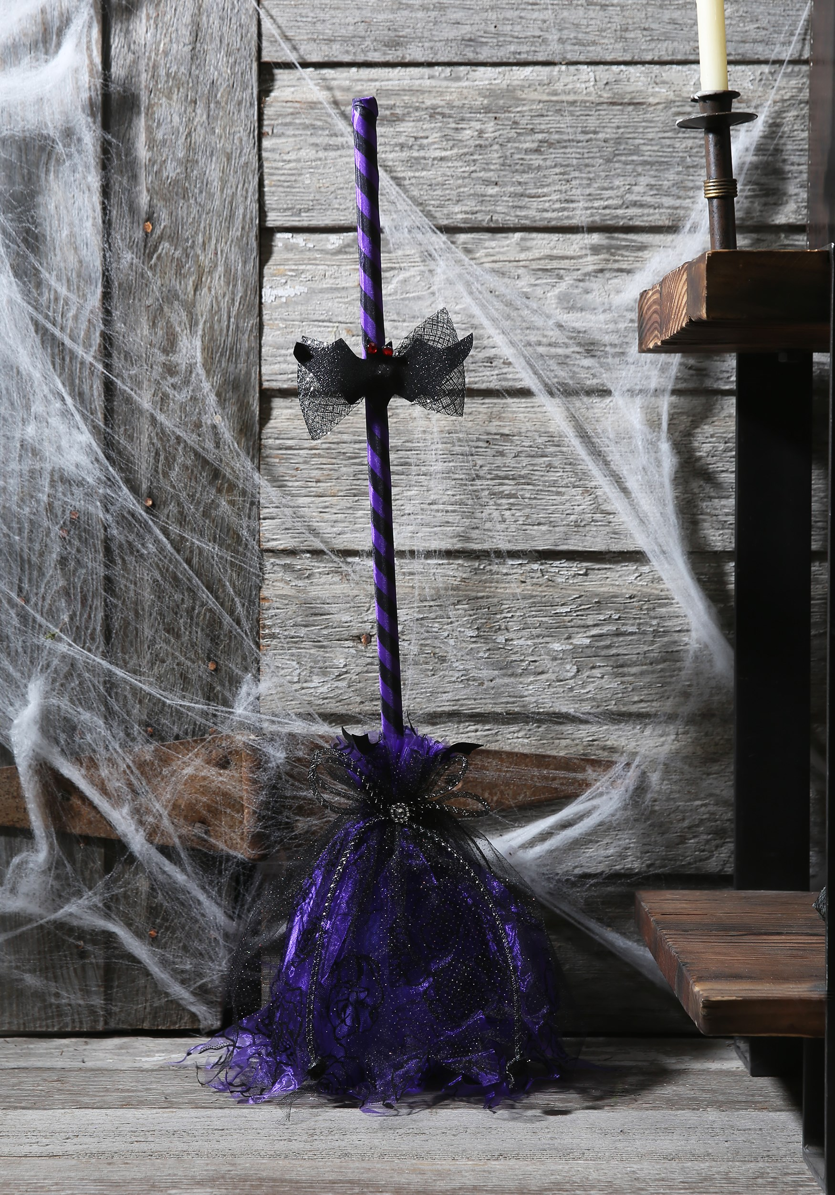
Unbelievable Short Stories:
‘Yes, Sir.’
Rawan Al fartusi
Unbelievable Short Stories:

Slide 2
Slide 2
“Amanda, please bring me the milk.”
“Yes, Sir.”
“Bring me the Nescafe box.”
“Yes, Sir.”
“Bring me that Choco Cupcake.”
“Yes, Sir.”
Amanda, a nice girl, who spend most of her life working. She was working when she was three, selling chocolate bars to get money for her parents, cleaning front yards, and doing chores.
She lived like that all her life, working, getting money, and giving the money to her parent.
When she grew up, she traveled from India to London, where she worked as a maid. The money she gets is always mailed for her parents.
She worked in a big house, where an old man in the age of 49 years lived.
His personality was unknown, he wasn’t nice, but not evil. He behaved to Amanda in a good way, not very much. Amanda slept in the basement, she slept on a mattress with a pillow, she had a small counter near her, where she put her two dresses, and a small notebook.
The man gave her one meal in a day, who was at night.
The meal was always a big meal, and she really liked it.
The man worked as a mechanic. Which was a very hard job for an old man. He went out for work at 7.30 A.M and returned home at 3.30 P.M.

Slide 3
Slide 3
Everyday, it was the same routine.
“Amanda, make me a cheese sandwich.”
“yes, Sir.”
“And make tea.”
“Yes, Sir.”
Amanda brings the food, and puts it on the table.
“Amanda, remove the spoon from the cup of tea. I told you don’t put the spoon, stir the tea and then remove the spoon, is everything clear?” “Yes, Sir.”
She writes in her notebook:
Always remove the spoon out of the tea cup.
The man eats his breakfast.
“Clean the table, and wash the dishes.”
“Yes, Sir.”
The man, before leaving the home, he hands Amanda a list.
“These are your chores, Amanda.” “Yes, Sir.”
Then, he leaves.
She reads the first three chores:
Wash the dishes.
Wash the clothes
Clean the house
She started working.

Slide 4
When the man returns home at 3.30 P.M, he says:
“Make lunch, Amanda.”
“Yes, Sir.” “And prepare the shower room for me.”
“Yes, Sir.”
She writes in her notebook:
Make Lunch.
Prepare the shower room.
She goes, and after 20 minutes, she puts the lunch on the table, and then go prepare the shower room.
The man goes to get a shower, then change his clothes, then go to the kitchen, and eats.
“Thanks, Amanda, now clean the table, then turn on the TV, tune it on channel 4.”
“Yes, Sir.”
She cleans the table, then go to the sitting room and turn on the TV.
“Amanda, go to the market, and buy these supplies.”
He hands her a list, and gives her money.
She goes to the supermarket.

Slide 5
She returns home, with all the supplies.
“Amanda, place the food in the fridge, and the shampoos in the counter near the sink in the bathroom.”
“Yes, sir.”
She finish the work, then says:
“is there any other work, sir?”
“yes, Amanda, go water the garden, then clean the front yard and the back yard, and wash all of the mattress in the house.”
“Sir, do you mean the bed mattress and the sofa mattress and the chairs mattress?”
“Yes Amanda.”
“Is there more work?”
“Clean my shoes, Amanda.”
“Yes, sir.”
She goes, waters the garden, clean the yards, wash the mattresses, and clean the man’s shoes.
The man goes to the kitchen, and says:
“Amanda, please come.”
“Yes Sir.”
“Can you help me?” “Yes sir.”
“Amanda, please bring me the milk.”
“Yes, sir.”
“Bring me the Nescafe box.”
“Yes, sir.”
“Bring me that Choco Cupcake.”
“Yes, sir.”

Slide 6
Amanda watches the man, putting three spoons of Nescafe in his cup, and pouring hot milk, and stirring, then, he says:
“stuff this food on the table, Amanda.” “Yes Sir.”
“Go have rest in your room, Amanda, you had a very hard day, right?” “No, sir.”
“If you feel tired from working, I can make your work less.”
“No sir, I am not tired, and this is my work.”
She goes downstairs, and reads a book.
“Amanda, come get your food.”
“Yes, sir.”
She goes upstairs to the kitchen, then downstairs, and eats.
Then she goes upstairs with the dishes, and goes to the man’s room, and says:
“any other work, sir?” “No Amanda, good night.” “Good night, sir.”

Slide 7
Amanda liked drawing, and it was the only thing she did during her free time. She was very good at drawing, but nobody did tell her that she was good.
One day, she went out to draw in the garden, and on the way home, she dropped one of her paintings, accidentally. Suddenly, a famous artist came on the way, and got hold of the painting, he saw Amanda walking by, and he followed her.
“Hey, you girl!” “Me?”
“Yes, is this your painting?” “Yes, thanks.”
He gave her the paper.
“I have one question.”
“Yes?” “I am a famous artist. I came from Denmark. I saw your painting, it’s amazing. Can you show me more paintings? You are excellent at drawing.”
It was the first time someone told her that she was good at painting.
“Thank you, sir.”
“do you want to study in my school? It’s called AOH, Artist’s Own Home. I am the principal. Every new student in AOH gets a small home.”
She was very happy. Because, she’ll get a home, and be a famous artist! But she thinked:
“What about my sir? He’s old, and if I leave him, he will live his life hardly, how can he do all of the work by himself?”

Slide 8
“No, I can’t, I am sorry, but I am a Maid.”
“No problem, but if you changed your mind, call me, and I don’t care of you are a maid.”
He gave her a sheet of paper, written on it his phone number.
“Thanks, gentleman.”
“Bye.”
On the walk home she thought:
“I’ll not leave my sir alone, anyway! He is very nice to me, and that basement I sleep in I like a Castle for me. He never shouted at me, and, I live the best life of all the other maids.”
So, that was the end of her life, she kept working for the old man, not because she likes him, because she Cares about him.
“Amanda, Please wash my clothes.” “Yes, sir.” “and tidy my wardrobe.”
“Yes, sir.”
“then go out and water the garden.” “yes, sir.”
“and make lunch.” “yes, sir.”
Wash clothes
Tidy Sir’s wardrobe
Water the plants
Make lunch

