Slide 1
Eiffel Tower
Rawan Al Fartusi
The Eiffel Tower is located in France, Paris, Champ de Mars. The construction started from January, 28, 1887 and did end in two years, two months, and five years, and did open in May, 15, 1889.
It heights 300.65 m and weights 10, 100 tons.
The Eiffel Tower is a symbol to Paris.
Eiffel Tower’s Architect was Stephen Sophistry, the engineers were Maurice Koechlin and Emile Nogier.
Eiffel Tower has three floors.
The first floor is located 57 meters from the surface of earth, with an area of 4200 square meters, and can accommodate the presence of about 3000 people at a time.
The second floor is located 115 meters from land, with an area of 1650 square meters, and it can carry 1600 people at a time.
The third floor is located 275 meters from land, with an area of 350 square meters, and can accommodate the presence of 400 people time.

Slide 2
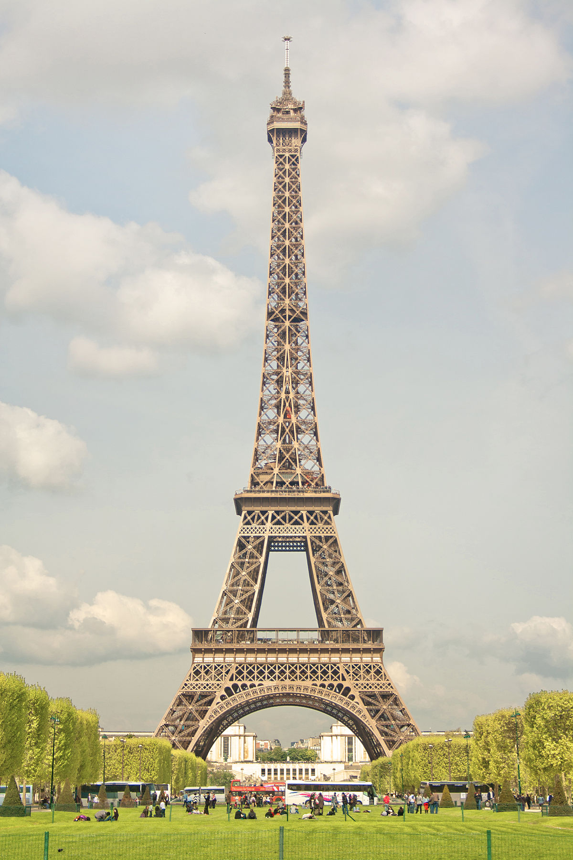
Slide 2

Slide 3
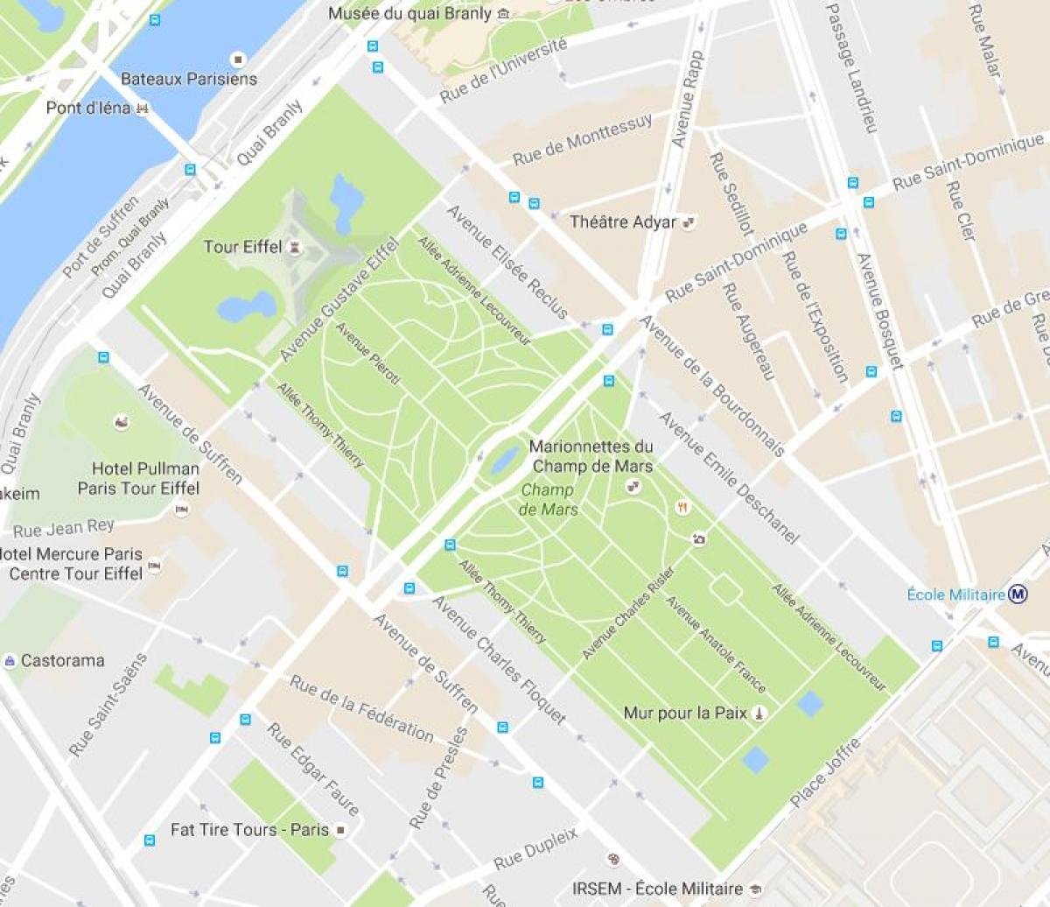
Slide 3

