Slide 1
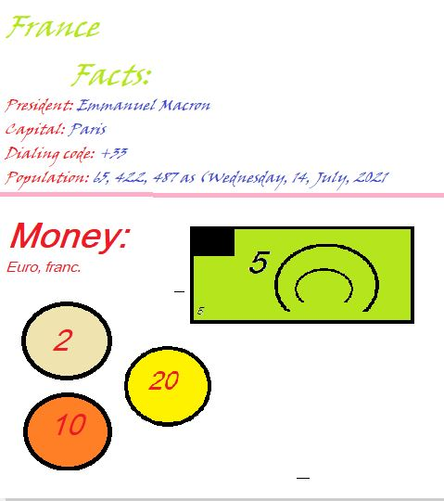

Slide 2
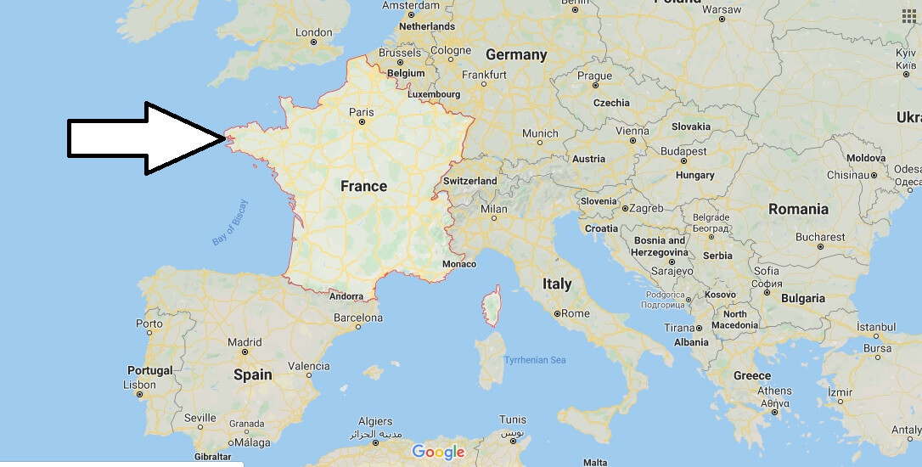
Slide 2
Location:
France is located in western Europe, between Germany and Spain.

Slide 3
Slide 3
Climate:
France is not a cold and not a hot country.
When it’s October it rains, and has rainy days till April, when it has dry and hot days till October.
France is a middle weather, or a medium weather, where it isn’t cold or hot.

