Slide 1
Happy Emirati Child Day!
Rawan Al Fartoosi

Slide 2
Hi Emirati kids? How do you do? Fine? Today is your day to have fun! Today is Emirati child day! Play all day because it’s your day to have fun! Make your future brighter & don’t forget to study hard to be a great character in the world when you grow! Wish you have the best marks in your exams and have 100/100!
What do you want to be?
O.K,,, so train hard to be what you want!!
Bye!!

Slide 3
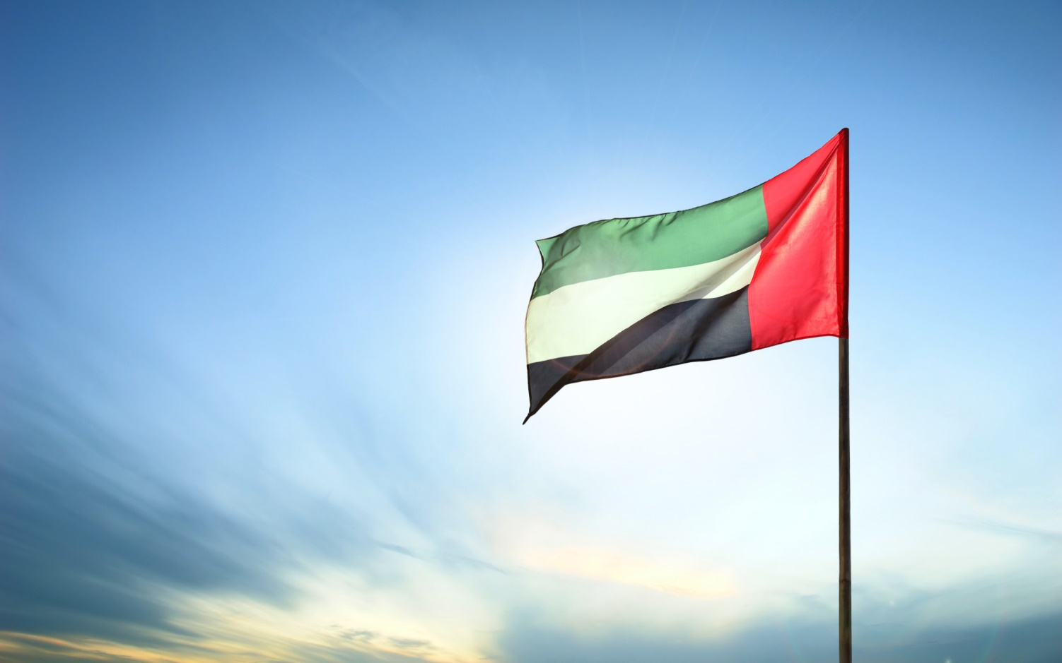

Slide 4
Do you like M. Zayed? If you like him study hard and work hard to make your town (Emirates) be the best town on earth!!!!

Slide 6
The impossible
is
Possible!

