Slide 1
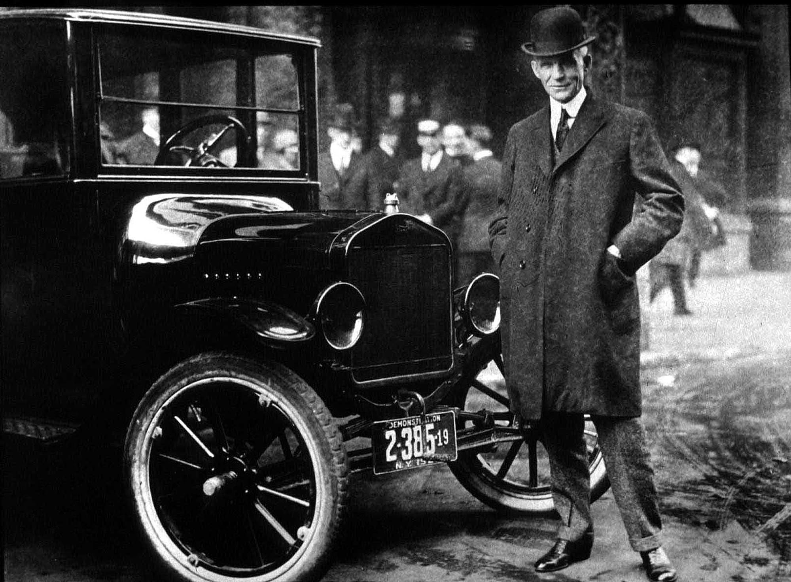
Henry Ford
By Rawan Al Fartusi

Slide 2
Slide 2
Henry Ford was a famous American entrepreneur.
He started the Ford Motor Company (FMC),
Which now sells millions of cars worldwide.
Henry Ford was born in 1863 in Dearborn, which is a town in Michigan. Henry grew on a small farm.
When he was 16 years old he moved to Detroit, the biggest city in Michigan.
He found a work in a factory, where he leant more and more about machines.
In 1896, he built his first car, which was called (Ford Quadricycle).
In 1903, he started the Ford Motor Company, then he invented a better car, which was Model T.
Model T was inexpensive, so a lot of people could buy it.
During Henry’s life, he sold more than 15 million Model T.
Henry died in 1947, in the age of 83.

Slide 3
Slide 3
Summary:
Born/ 1863, Dearborn, Michigan
Work/ 16 years old, moved to Detroit, Michigan, a factory.
First car/ 1896, Ford Quadricycle
Company/ 1903, FMC ford motor company
First car in FMC/ Model T
Died/ 1947, age 83

Slide 4
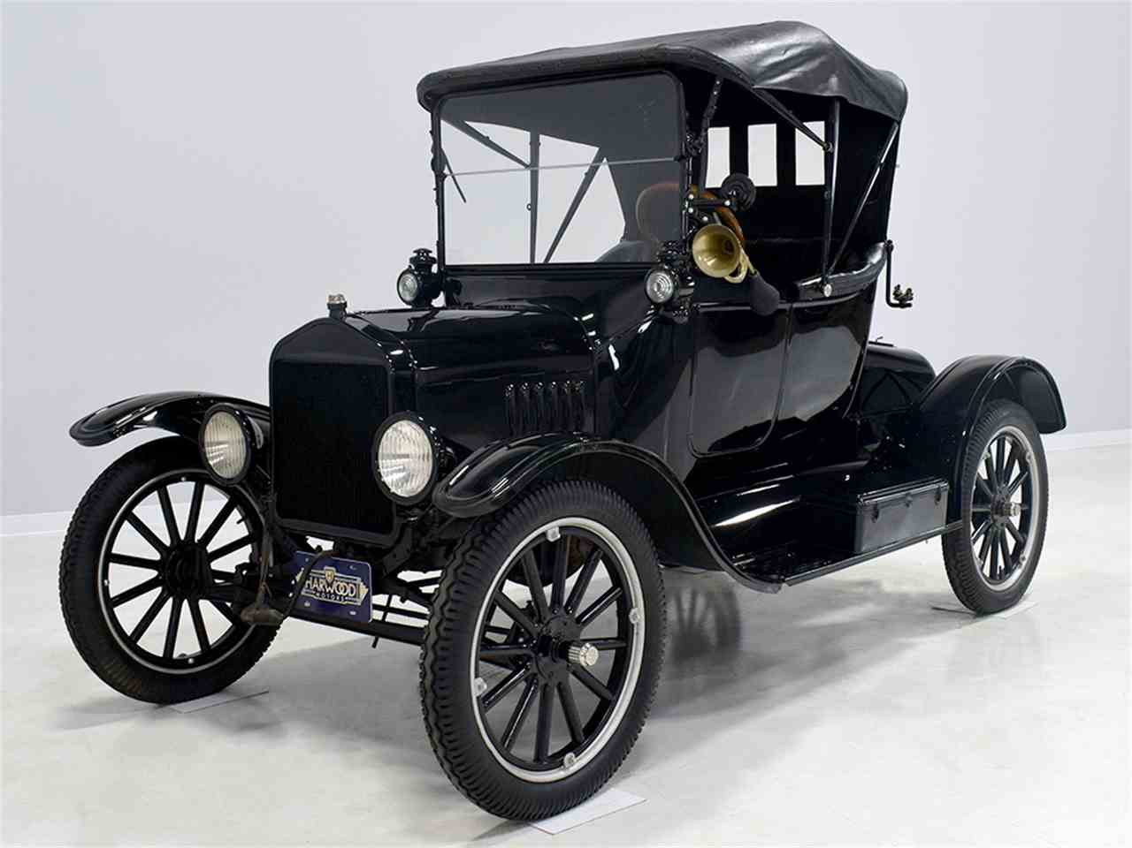
Model T

Slide 5
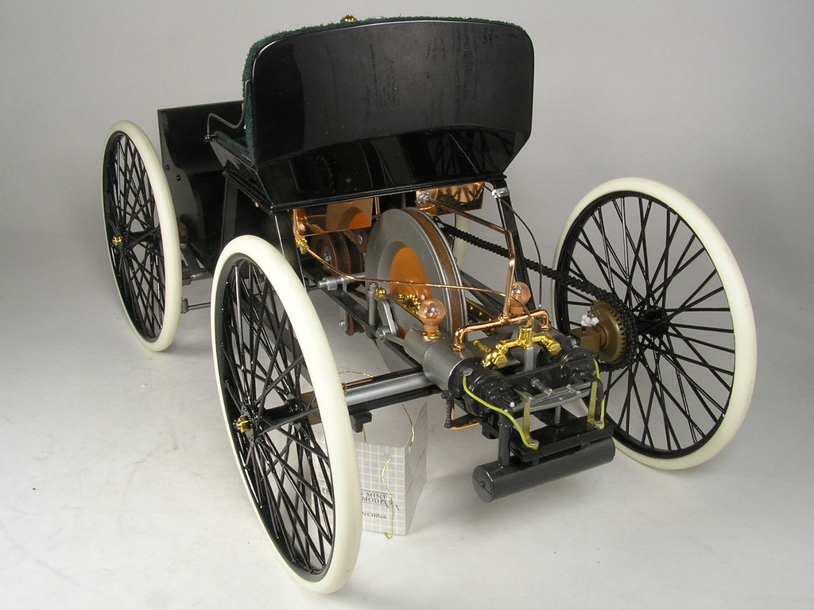
Ford Quadricycle

