Slide 1
How Saudi Arabia use old machines
Rawan Al Fartusi

Slide 2
Some companies in Saudi Arabia that work in aluminum and gold use old machines to take aluminum, gold, and other minerals. But how?????
This is our question, Saudi Arabia use old machines like old cell phones and tablets to make minerals, but how?
This is the second question, RAMs, and some parts of electronic devices have GOLD and minerals in, even in SIM cards!
Companies take the minerals and use it. Companies make too much money from that, by selling gold to the town that need. Also they use wires from machines and sell it to the town that needs, and some times they use it for their town.

Slide 3
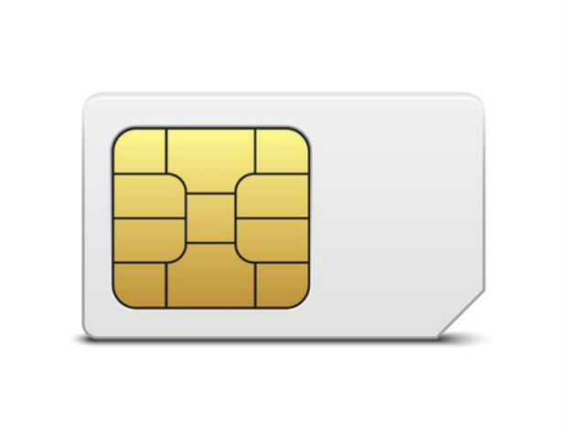

Slide 4
المعلومات من: مسلسل سن لرمضان 2021
ترجمة الى الانكليزي: روان فرطوسي

