Slide 1
Mr. Bean
Rawan Al Fartusi
Mr. Bean is a British Sitcom created by Rowan Atkinson and Richard Curtis, produced by Tiger Aspect and starring Rowan Atkinson as the title character, (Mr. Bean).
Mr. Bean is one of the silent films, not because Rowan Atkinson liked the idea of a silent film, but because Rowan Atkinson suffered from stuttering, where he couldn’t speak or pronounce words very well.
Mr. Bean actually won awards, and the first episode won the “Golden rose Award”.
Seven years following the end of the live action series, Mr. Bean reappeared in an animation series.
From 2002 till 2004, 52 episodes were originally broadcast on ITV1 each consisting of two 11 minutes segments. In 2015 CITV commissioned a brand new series of episodes, and 78 new episodes began broadcasting from 6 February 2015.
Two books tied – in to the original live action series were released: Mr. Bean Diary and Mr. Bean pocket diary.

Slide 2
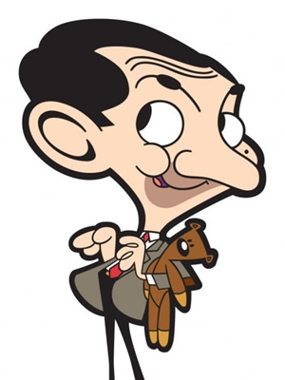
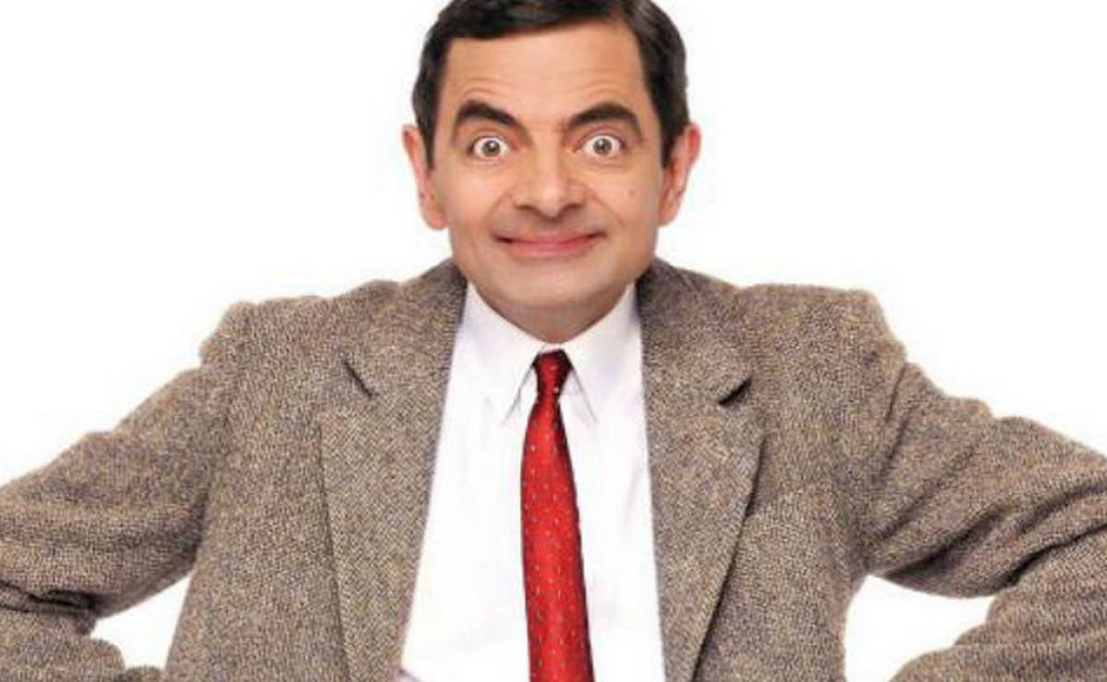
Slide 2

Slide 3
Slide 3

