Slide 1
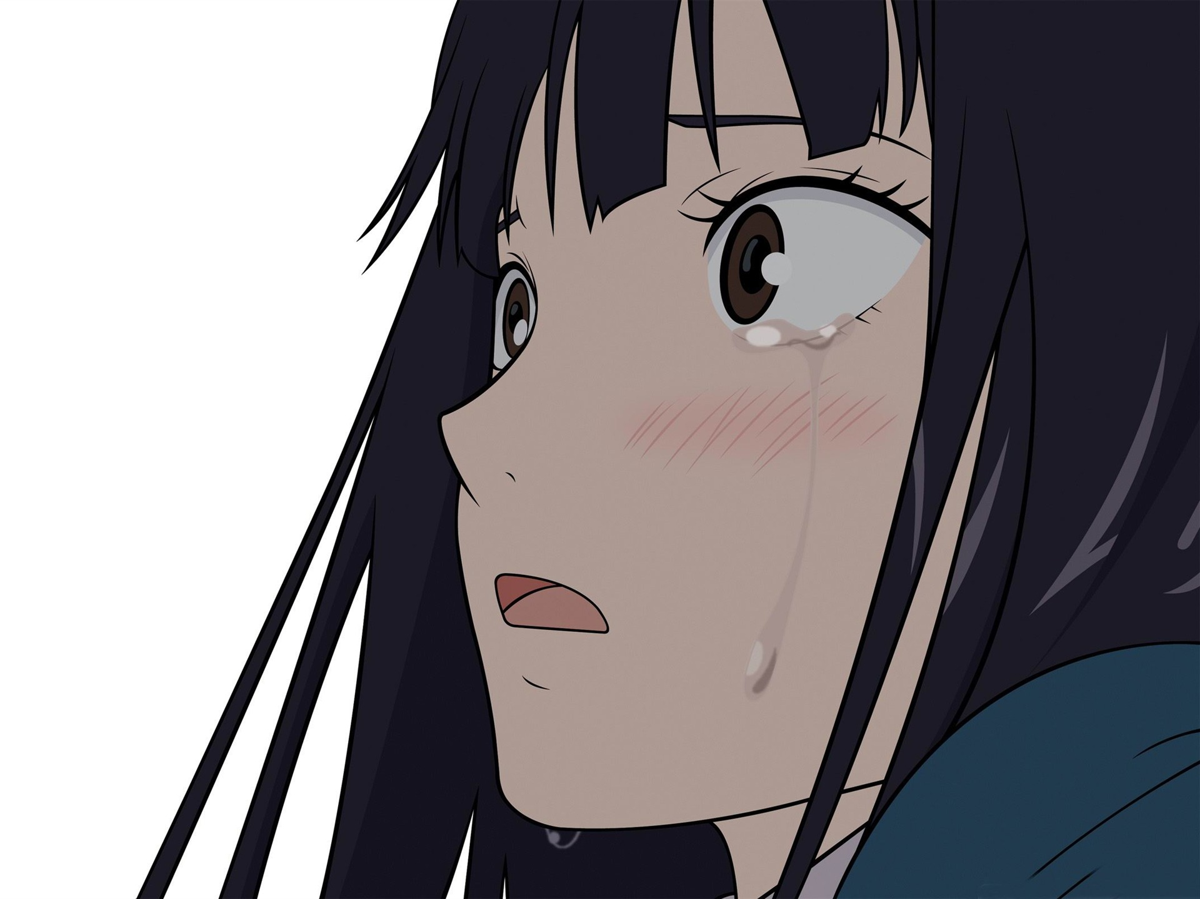
Unbelievable Short Stories:
Dear Father

Slide 2
Slide 2
When Aoki’s dad, Yuuichi, died, She and her mum lived alone in the house.
Aoki really liked her dad, and when he died, she was always sad, and didn’t laugh, or even smile.
Even thought her mum always cheer her, she didn’t feel better, Aoki didn’t even talk or eat much, and she couldn’t sleep because of her nightmares.
Her health was getting bad and bad over time, she was getting very thin and unhealthy.
And one day, when her mum returned home from work, she said:
“you’re getting a step father dear.”
Aoki, with her low voice, said: “a stepfather?”
And tears started running down her cheek.
“you want to change my father? I don’t agree, I only have one father, one nice father, and you’ll never change him, anyway you try to!”
This time, Aoki shouted, with a higher voice.
“no dear, don’t worry, your stepfather is as nice as your father, no, don’t cry, no prob-”
“as nice as my father? No way! My dad is the best father, and nobody is better than him, yes, nobody.”
Aoki ran upstairs to her room, and closed the door really hard.

Slide 3
Slide 3
Knock – knock – knock
The mum knocked Aoki’s bedroom door.
“Aoki, please open, dear. Why are you very sad? I didn’t say anything wrong, why aren’t you happy? You are finally having a step father.”
“Happy? How can I be happy if you are trying to change my dad?”
“ok, then I’ll leave you alone.”
After 30 minutes, Aoki came down stairs to the kitchen, where her mum was sitting, and said, with a very low voice:
“I’m sorry mum. I didn’t mean to hurt your feelings, but I was very angry.”
“no problem dear, I forgive you.”
“but I’ll never like my step father as a like my very own father.”
“come dear, why don’t you drink a cup of hot tea?”
Aoki and her mum drank hot tea together.
“Yuuummm! This tea is super delicious, mum.”
“Yeah, better than your dad’s tea, right?”
“yeah mum, my dad tea was, mmm, I don’t know, disgusting?”
“yes Aoki, the perfect word, Disgusting!”.
“Oh mum! It’s 9.30, tomorrow I have school! Good night mum!”. “Good night dear”.

Slide 4
Meep – meep – meep – meep – meep
Aoki alarm went on at 6.30 A.M.
“Good morning dad. How are you? You are looking so dressed today, why? Are you gonna meet a famous reporter? A famous writer? Or a famous singer?”
Aoki talked with the photo sitting on her desk near her bed next to her alarm clock.
She stared at the photo and said:
“you always told me to smile, but how can I smile if you weren’t next to me? You always told me to never give up and never cry, but here I am, sad, crying almost every time, and I totally gave up! Sorry dad, but I can’t live without you.”
After a lot time of staring, she finally got out of bed, brushed her teeth, washed her face, got dressed and grabbed her bag, she went downstairs to eat breakfast.
“good morning dearest.”
Said the mum.
“good morning.”
Said Aoki, with her low, sad, and weak voice.
Aoki only drank tea for breakfast.
“Why didn’t you eat your eggs?” “I’m not hungry.”

Slide 5
“I’m going to school mum.”
“But I think it’s very early.”
“no, it isn’t”
“so, good bye dearest”
“good bye”
When she got home from school. She saw a man sitting on the living room couch, and her mum was next to him. “Mum, who’s this man? And what’s he doing in our house?”
“he’s your step father, Aoki.”
“What?”
“You step father, come and meet him, sweetheart.”
“Mum, I told you I don’t want a new father, I only want my original father! Why are you trying to change my dad, I don’t want anyone only my dad! I don’t want to change him!”
Aoki shouted, and tears run down her cheek.
“No sweet heart, don’t cry please!”
Aoki ran upstairs to her bed room, and buried her face in her pillow, and started crying.
“Why, why, why? Why did you leave me alone, father? I don’t have anybody, only you.”

Slide 6
“I’m sorry, Akira, but my daughter isn’t very ready to meet you, I’m very sorry.”
The mum told the step father, Akira.
“No problem Ana, I will go and meet her, she looks very nice, and I do feel how she feels, I lose my dad too, and when my mum showed me my step father, I got very angry, and ran outside. She don’t mean to her your feelings, or even my feelings, she isn’t bad, only she miss her dad, and don’t want to change him.”
Akira told the mum, Ana.
Akira went up stairs, and slowly opened Aoki’s bedroom door, then slowly sat down on her bed, and put his hand on her, while she was buried with her pillow, crying.
“GO AWAY.”
She shouted.
“Why are you crying?”
“Not your business”
“I feel how you feel”
“Do you?”
“I used to be an only child, like you, and I lived with my parents. And one day my dad went to a trip, and died because of an accident. He used to be very nice, and till now I still miss him.”

Slide 7
“You still miss him?”
“Yes, I do, when I first met my step father, I was very angry that I actually ran out of the house, and got lost! Mum called the police and they started searching for me. Then finally found me.” Aoki sat down next to her step father and asked him: “Where did you hide?” “in my mum’s car!”
“Ha-ha! Did the police get angry?”
“No, they actually had fun when they found me, and one police said ‘How stupid we are! We couldn’t find someone who was actually hiding in a simple place.’
Then, I just lived with my step father as I did with my original father.”
“My name is Aoki Yuuichi, What’s your name?” “Akira Tsurugi.”
“I’m very sorry I was angry.”
“No problem”
“Can I call you ‘dad’?”
“Only if you allowed me to call you ‘daughter’.”
Then, they started laughing, and Aoki hugged Her step father.

Slide 9
‘ Thanks dad
for
Building me a land’

