Slide 1
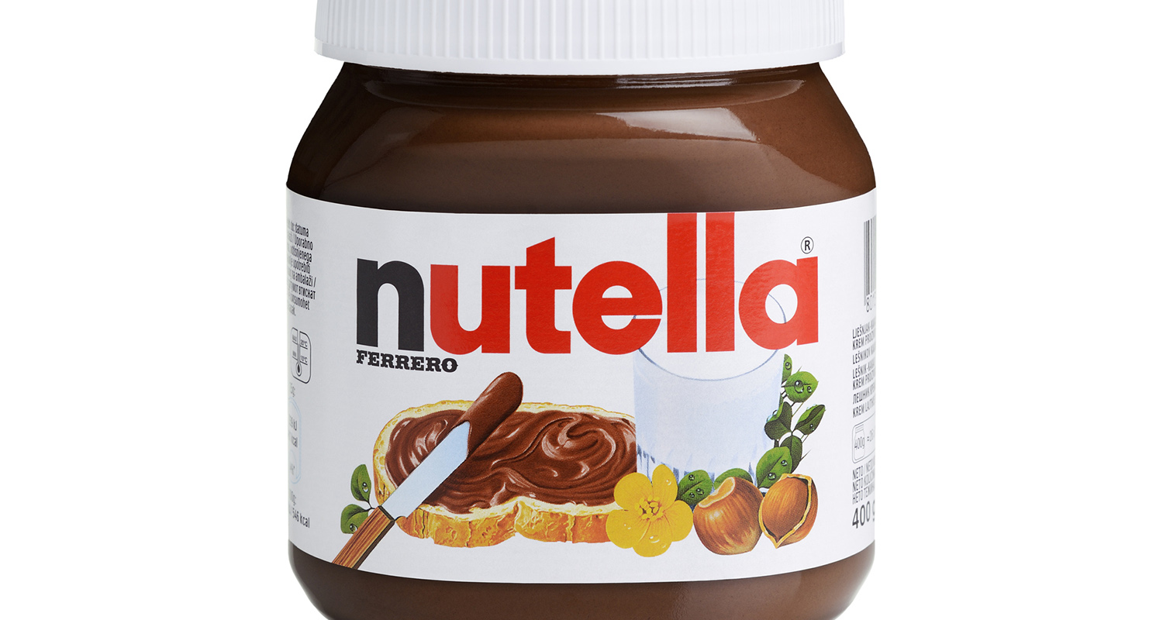
Slide 1
Nutella’s dark side:
By Rawan Al Fartusi

Slide 2
Slide 2
Nutella, the (correct) ingredients
When you see the ingredients, this is what is written:-
But these are not the real ingredients, when you visit Kellogg or nestle ‘s site, this is what you’ll see:-

Slide 3
Slide 3
so the real ingredients are 13% hazelnuts ONLY!
And 7.4% cocoa powder.
And one very important fact of Nutella, it’s made of 55% sugar!
But one positive thing, Nutella don’t have any artificial colors.

Slide 4
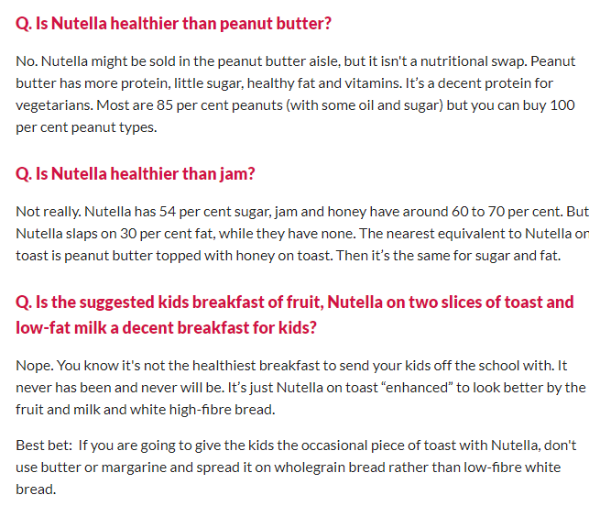
Most asked questions

Slide 5
What made Nutella really popular? - it’s ads, yes, it’s ads. It’s ads always showed that Nutella was mostly made by Hazelnuts, not sugar, and showed that kids admired it.

Slide 6
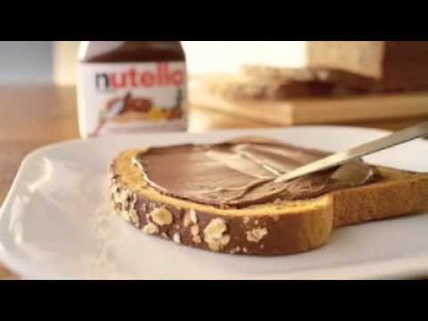
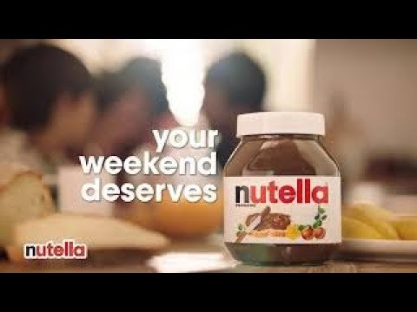

Slide 7
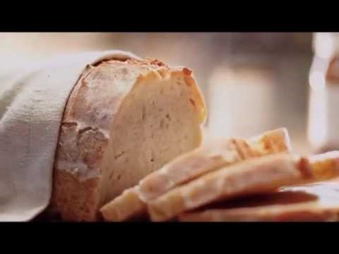
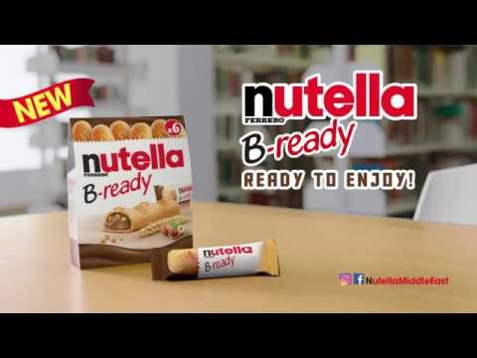

Slide 8
